Slide 1
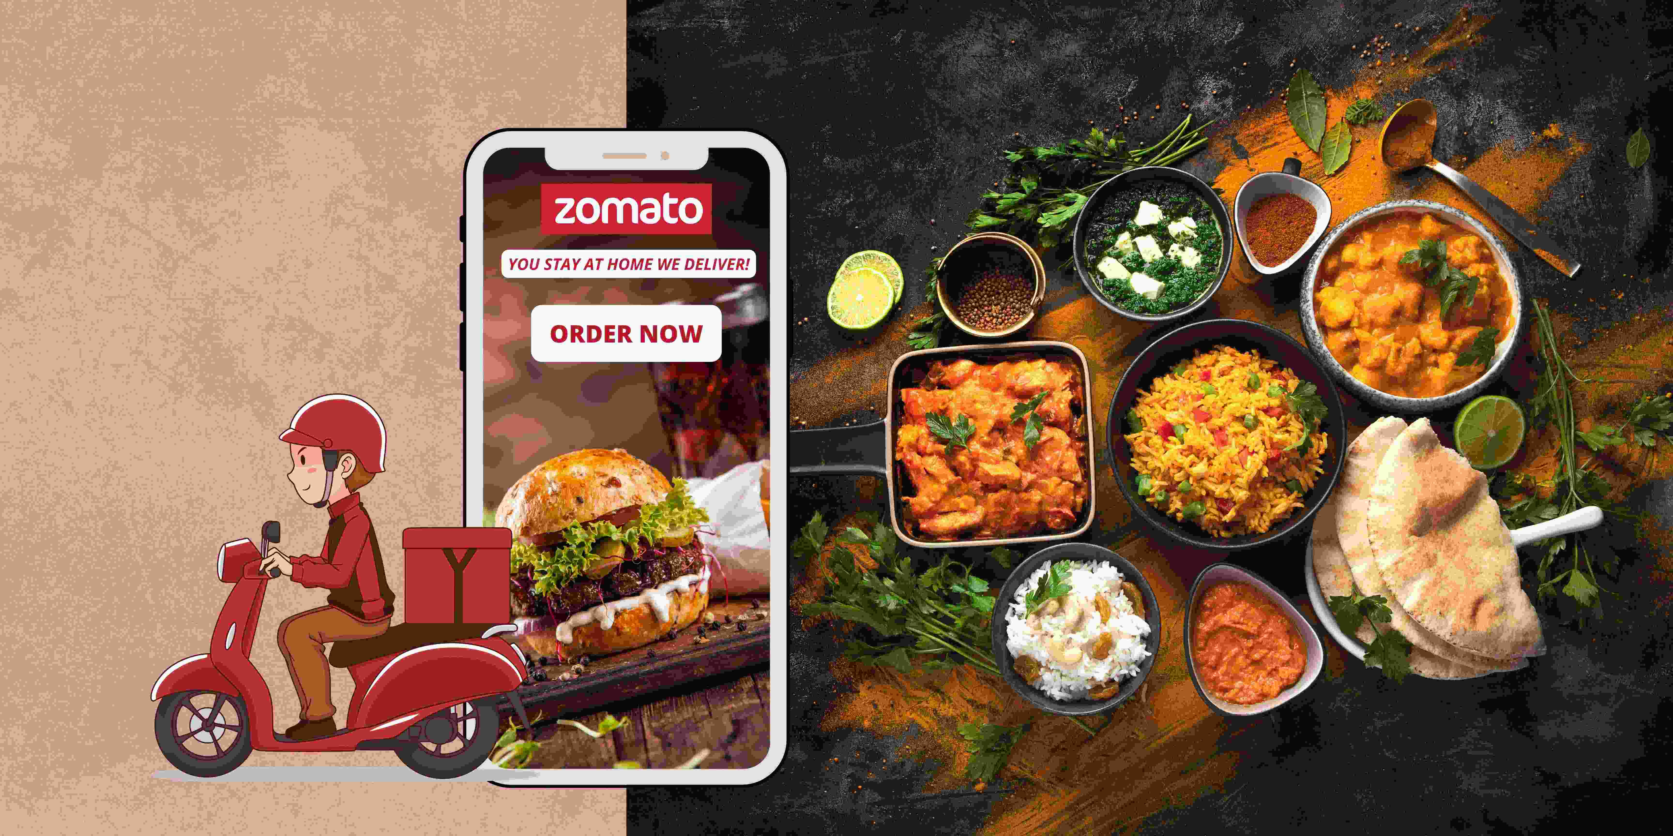
Zomato Restaurants Analysis
Prashant Shandilya

Slide 2
Introduction
Zomato is a global restaurant search and discovery service founded in 2008.
Founded by Deepinder Goyal and Pankaj Chaddah in India.
Offers food delivery, restaurant discovery, reviews, and table reservations.
Operates in over 24 countries and more than 10,000 cities.
Generates revenue through food delivery commissions, advertising, and subscription services like Zomato Gold.
Utilizes AI and machine learning for personalized recommendations and efficient delivery logistics.

Slide 3
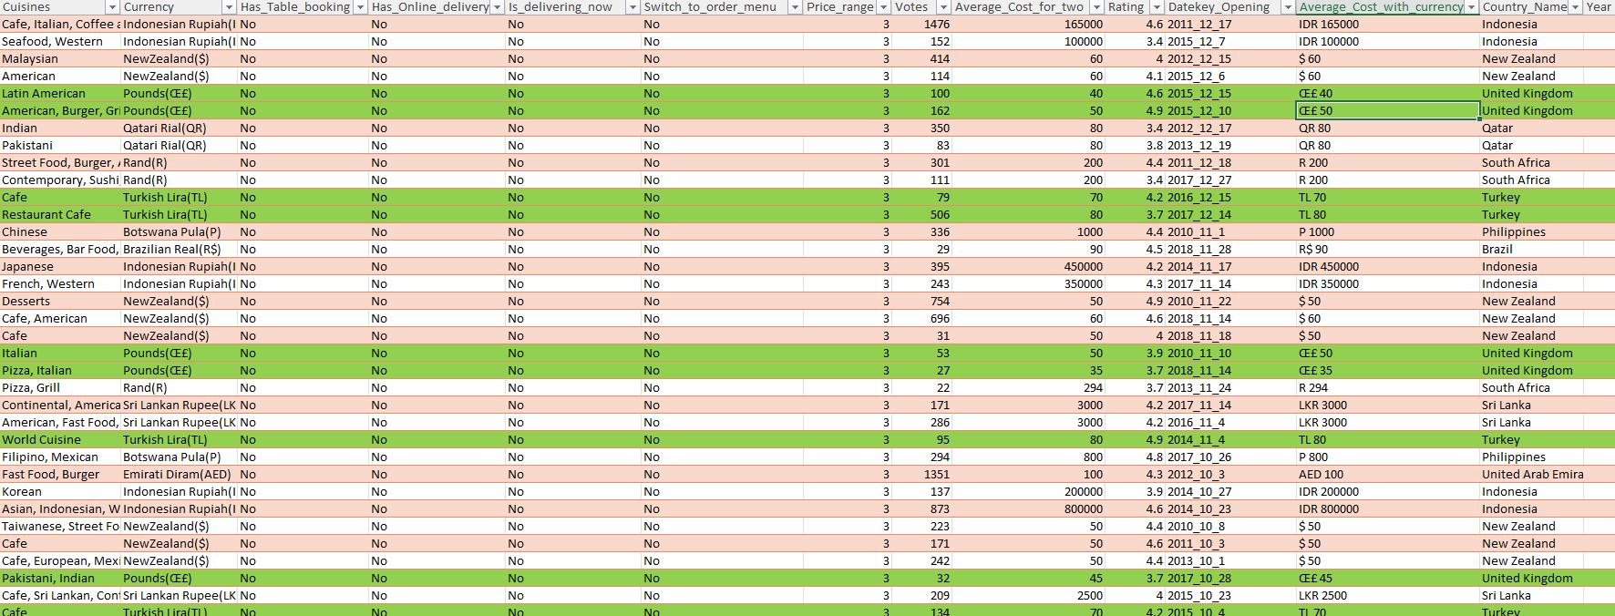
Objective
Provide data-driven strategies to identify optimal locations for new restaurants.

Slide 4
Expansion Strategies for New Restaurant Openings
Identify high-growth regions using demographic and geospatial data.
Analyze market trends and competitor presence.
Leverage Zomato’s customer data to understand dining preferences.
Focus on popular cuisine types and emerging food trends..
Conduct cost-benefit analysis for each potential location.

Slide 5
Data Analysis Workflow for Restaurant Expansion
Data Collection
Data Cleaning and Preparation
Data Analysis
Visualization
Decision making

Slide 6
Data Description
Attribute | Description
Restaurant ID | Unique identifier for each restaurant
Restaurant Name | The name of the restaurant
Country Code | Country code of the location
City | The city where the restaurant is located
Address | The specific address of the restaurant
Cuisines | The type of cuisine offered by the restaurant
Price Range | Numeric value indicating price category
Votes | Number of votes/ratings received
Average Cost for Two | Average cost for two people dining
Rating | Overall rating based on user reviews

Slide 7
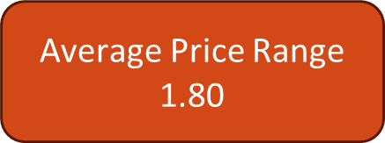
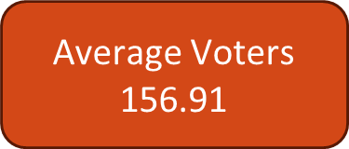
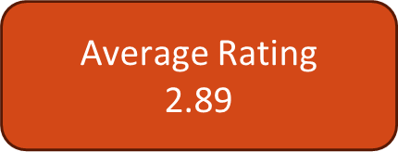
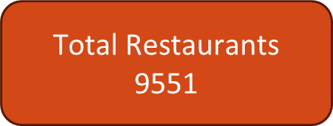
Key Performance Indicators
Price Range :- The location should not be highly expensive, ensuring that operating costs are manageable.
Average Votes Count :- A higher number of votes indicates a strong visitor count, suggesting a popular area.
Average Rating :- A better average rating reflects higher customer satisfaction, which is crucial for customer retention.
Restaurant Count :- The area should not be saturated with restaurants, providing ample room for growth in new markets.

Slide 8
Restaurants Count By Country
India | 8652
United States of America | 434
United Kingdom | 80
Brazil | 60
South Africa | 60
United Arab Emirates | 60
New Zealand | 40
Turkey | 34
Australia | 24
Philippines | 22
Indonesia | 21
Sri Lanka | 20
Singapore | 20
Qatar | 20
Canada | 4

Slide 9
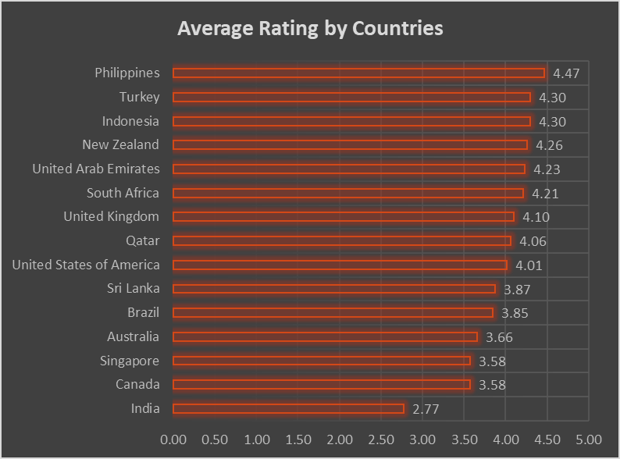
Average Rating by Countries

Slide 10
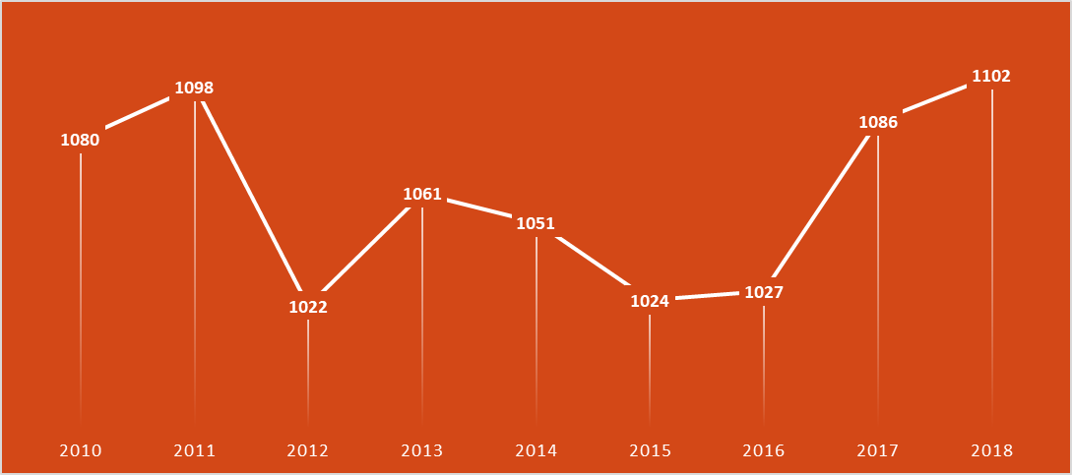
Restaurants Count By Year
2010 | 1080
2011 | 1098
2012 | 1022
2013 | 1061
2014 | 1051
2015 | 1024
2016 | 1027
2017 | 1086
2018 | 1102

Slide 11
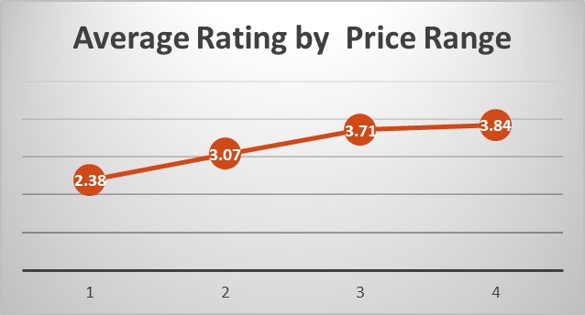
Average Rating by Price Range

Slide 12
Data Summary
Country | Average of Price_range | Average of Rating | Count of RestaurantID | Average of Votes
India | 1.72 | 2.77 | 8652 | 137.21
United States of America | 2.05 | 4.01 | 434 | 428.22
Australia | 2.13 | 3.66 | 24 | 111.42
Canada | 2.50 | 3.58 | 4 | 103.00
United Kingdom | 2.75 | 4.10 | 80 | 205.49
Turkey | 2.82 | 4.30 | 34 | 431.47
Sri Lanka | 2.85 | 3.87 | 20 | 146.45
Indonesia | 2.95 | 4.30 | 21 | 772.10
New Zealand | 3.15 | 4.26 | 40 | 243.03
United Arab Emirates | 3.22 | 4.23 | 60 | 493.52
Philippines | 3.36 | 4.47 | 22 | 407.41
Brazil | 3.40 | 3.85 | 60 | 19.62
South Africa | 3.58 | 4.21 | 60 | 315.17
Qatar | 3.65 | 4.06 | 20 | 163.80
Singapore | 3.65 | 3.58 | 20 | 31.90

Slide 13
Selection Criteria
Restaurant Count < 100
Average Price range < 3
Average Rating > 4
Average Votes > 200
Countries selected
United Kingdom
Turkey
Indonesia
Country | Average of Price_range | Average of Rating | Count of RestaurantID | Average of Votes
United Kingdom | 2.75 | 4.10 | 80 | 205.49
Turkey | 2.82 | 4.30 | 34 | 431.47
Indonesia | 2.95 | 4.30 | 21 | 772.10

Slide 14
Cities selection
On Analysing at the city level I have shortlisted the below cities as their average price range is not more than 3 and their average rating in more the 4.25.
London
Ankara
Istanbul
Jakarta
City | Average of Price_range | Average of Rating | Count of RestaurantID | Average of Votes
United Kingdom | 2.75 | 4.10 | 80 | 205.49
Birmingham | 2.40 | 3.73 | 20 | 69.65
Edinburgh | 2.90 | 4.09 | 20 | 112.30
London | 3.00 | 4.54 | 20 | 436.20
Manchester | 2.70 | 4.05 | 20 | 203.80
Turkey | 2.82 | 4.30 | 34 | 431.47
Ankara | 2.80 | 4.31 | 20 | 131.35
ÛÁstanbul | 2.86 | 4.29 | 14 | 860.21
Indonesia | 2.95 | 4.30 | 21 | 772.10
Bandung | 3.00 | 4.20 | 1 | 22.00
Bogor | 2.50 | 3.85 | 2 | 971.00
Jakarta | 3.00 | 4.36 | 16 | 742.69
Tangerang | 3.00 | 4.30 | 2 | 1183.50

Slide 15
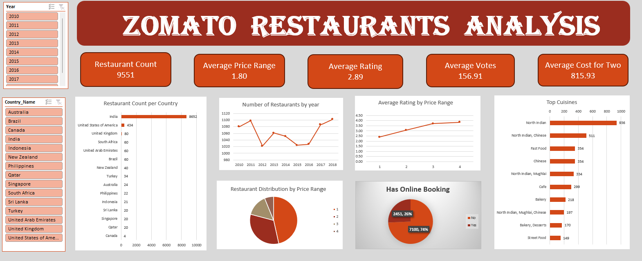
Zomato Restaurants Dashboard

Slide 16
Conclusion
A data-driven approach will ensure targeted and successful restaurant expansions.
Continuous monitoring and adaptation to market trends and customer feedback are crucial.
A higher number of votes indicates a strong visitor count, suggesting a popular area.
By leveraging Zomato data and market research, we can make informed decisions to maximize the success at new locations.
Non saturated restaurants provides ample room for growth in new markets.
A higher average rating indicates greater customer satisfaction, which is essential for retaining customers.

Slide 17


